Slide 1
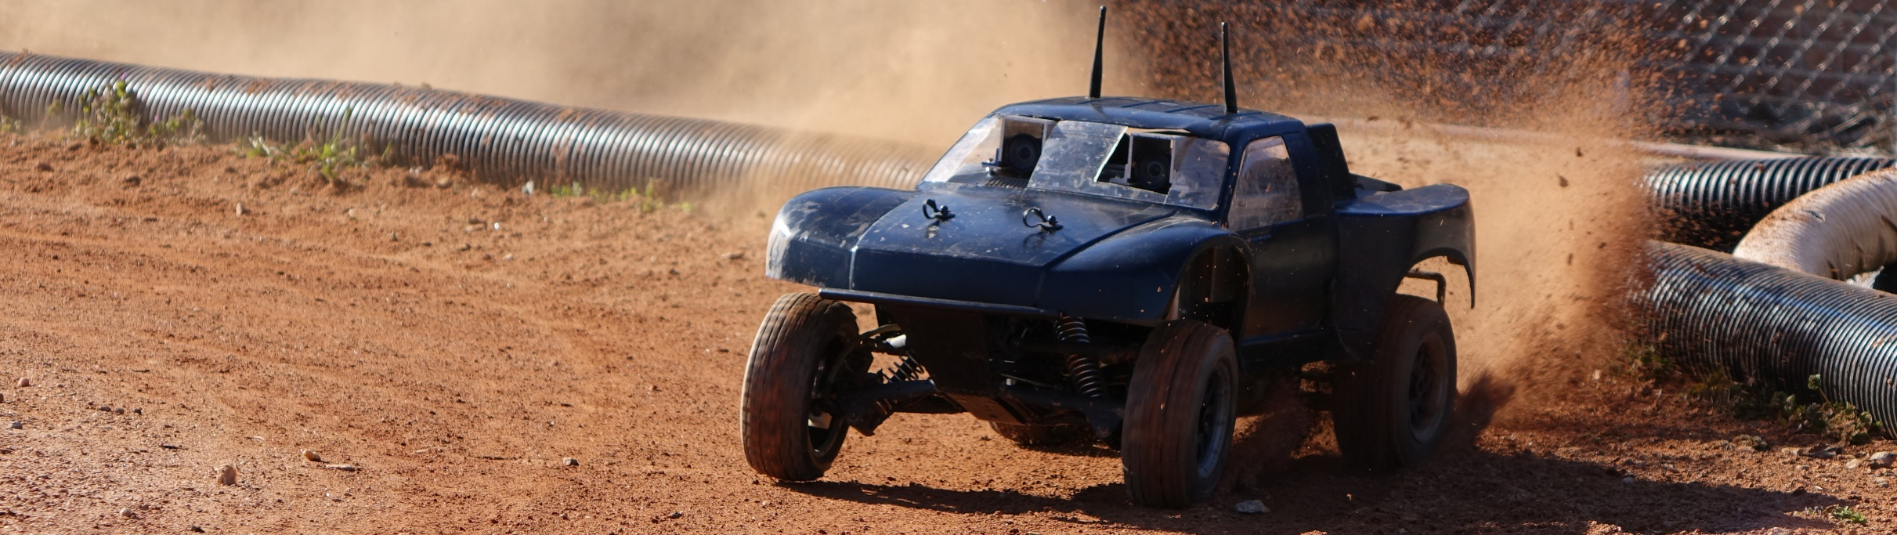
Autonomous RC (ARC)
Cierra Shawe, Tao Chen, Daniel Stoyer
Figure 1
Figure 1: image from https://autorally.github.io/
Notes:
Depends on how intelligent our system is: like a human driving a car doesn’t need to understand the steering ratio of the car. If the turning angle is too small, a human would just apply more steering. That requires a more sophisticated system.

Slide 2
Introduction
What ARC is all about!

Slide 3
Introduction
The purpose of the Autonomous RC (ARC) project is to determine if it is possible to build an autonomous RC vehicle using commodity components, meaning components that are relatively inexpensive and can be bought at places like Radio Shack®, Best Buy®, or on Amazon®.

Slide 4
Introduction
Our goal is to make an RC vehicle navigate autonomous to a given waypoint/location, preferably at a high rate of speed. Stretch goals are to make the vehicle drift around corners and parallel park.

Slide 5
Overview of Design
Our approach to the ARC design

Slide 6
Overview of Design
Experimental model using milestones: The uncertain nature of the ARC project requires us to set capability milestones to measure against.
Milestone #1:
Milestone #2:
Milestone #3:

Slide 7
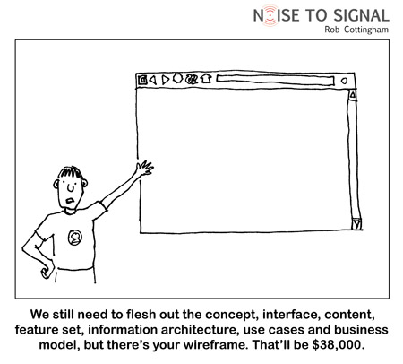
Current State of ARC
Figure 2
Figure 2: image from http://digitalsynopsis.com/wp-content/uploads/2015/03/web-designer-developer-jokes-humour-funny-12.jpg

Slide 8
Just kidding!
Here is where we are at …

Slide 9
Activities Summary
A summary of weekly activities, problems, and solutions.

Slide 10
Weeks 1-2
Weeks one and two were general introduction and orientation weeks. It was not until week 3 that projects started in earnest and the first assignment was assigned.

Slide 11
Week 3
Activities: Worked on creating the problem statement. This required getting an overall understanding of what our autonomous RC vehicle should be able to do. In other words, getting on paper the expectations of our client for the final product. We also started researching what we would need for the SRS document, both in terms of the ARC project and in terms of the LaTeX document. We needed a Gantt chart for the SRS, so we started researching how to do that.

Slide 12
Week 3
Problems: Our client was ill during this time, so feedback for the problem statement was understandably delayed. We struggled a little with using the proper tense in the document and getting a high-enough, yet detailed enough written view of the ARC project. We needed clarification on details for the expected vehicle capabilities.

Slide 13
Week 3
Solutions: We talked with our client on how to frame our project appropriately. For the vehicle capabilities, our client told us to aim high, if we need to scale things back later we will.

Slide 14
Week 4
Activities: Received feedback on our problem statement and made required changes. We needed to clarify what our motivation for the project was, namely that we are trying to create an autonomous RC system that is considerably less expensive than current research platforms (think $1-2k vs $10-15k). Created a template for the SRS document and started looking into what requirements our project needed.

Slide 15
Week 4
Problems: The three of us on the ARC team have no prior experience with ECE, in general and Autonomy or RC vehicles, in particular. This lack of experience makes writing these beginning documents somewhat abstract because we do not know what is involved.

Slide 16
Week 4
Solutions: We spent time with our client to talk through some of the requirements. Clarifying why this project matters also helped us narrow the scope of our requirements a little bit. We could focus on low-cost, readily available components. While that still leaves quite a bit to discover, it also eliminates expensive, yet otherwise viable, options.

Slide 17
Week 5
Activities: Worked on the SRS document. This phase of the project required us to brainstorm what components our system needed and how they fit together. For instance, system interfaces has many parts so we had to sit down and talk through what connects and talks to what and visualize how that looks. For the SRS, filled out the introduction, software interfaces, communications interfaces, and the overall layout of the general control flow. Researched how to construct a Gantt chart in LaTeX. We also decided on what parts we each would take responsibility for and write about in the tech review document.

Slide 18
Week 5
Problems: The SRS document needed different indexing (numeric, as opposed to Roman numeral). This required some effort to figure out how to reformat the document to use a different indexing scheme without changing the controlling document class. Other problems: The nature of our project is complex. Therefore, there are many parts to the requirements for this project. We needed to estimate what the project would need, but again, without experience. Researching and building a working Gantt chart in LaTeX took about 9 hours. The system is very cumbersome, which makes one not want to revisit it to make changes.

Slide 19
Week 5
Solutions: Fixed the LaTeX index formatting issue by adding an argument to the IEEEtran.cls options. This turned out to be a pretty easy fix, but took quite a while to figure out. We tackled the complexity of this project by meeting together and drawing out a rough sketch of major components and how they relate to each other.

Slide 20
Week 6
Activities: This was a very research-heavy week. We did in-depth research on our main areas of emphasis: system interfaces, user interfaces, hardware interfaces, communications interfaces, sensors, navigation, hardware mounting (how to physically attach the components to the vehicle), system control and data processing, and path planning. We created a block diagram of the structure and data flow of the project. We worked simultaneously on the tech review and SRS documents. This is likely going to be a better strategy moving forward, research some area of the project, determine a requirement based off of the research, try to implement, record our findings and adjust the requirements further if necessary.

Slide 21
Week 6
Problems: Which came first, the chicken or the egg? This is how it feels to be writing the documents for this research project. In order to know what requirements are reasonable/feasible, we need to know what tech is out there and if/how it fits with related components.

Slide 22
Week 6
Solutions: To get around some of the issues we are having we decided to write the SRS and the tech review somewhat concurrently. This allowed us to research our areas of the tech review and then have a better understanding of what a reasonable requirement might be for the project.

Slide 23
Week 7
Activities: This week was very similar to week 6, as we continued to research more about our topics and headway on the SRS. We managed to finish the introduction of the document and we described the general interfaces between components, even though we were unsure of what components were going to be used.

Slide 24
Week 7
Problems: The biggest problem we had this week were sifting through hardware documentation, that was well... lacking in the documentation aspect. The SRS document was also conceptually difficult without having an understanding of the technology behind it, which made it feel as if in order to finish the SRS, namely the requirements section, we would need to do the tech-review first to have a better understanding of what the realistic capabilities of the technology Another problem was trying to make progress on the SRS document without having completed the tech review first.

Slide 25
Week 7
Solutions: We spent more of our time researching to gain a better understanding of what we would need to do. When we found technology that seemed promising, we would add it as a component to our tech review. Stepping back to look at the broader picture also helped us be able to fill out a good portion of the first half of the document.

Slide 26
Week 8
Activities:

Slide 27
Week 8
Problems:

Slide 28
Week 8
Solutions:

Slide 29
Week 9
Activities:

Slide 30
Week 9
Problems:

Slide 31
Week 9
Solutions:

Slide 32
Week 10
Activities:

Slide 33
Week 10
Problems:

Slide 34
Week 10
Solutions:

Slide 35
User Interface
User interface (UI) is how the user and system communicate with one another. This is one Dan’s areas of focus.

Slide 36
Why?
Without UI nothing happens.

Slide 37
How?
GUI
CLI
Graphical User Interface
Most likely to be used on the ground station.
Command Line Interface
Most likely to be used on the companion computer

Slide 38
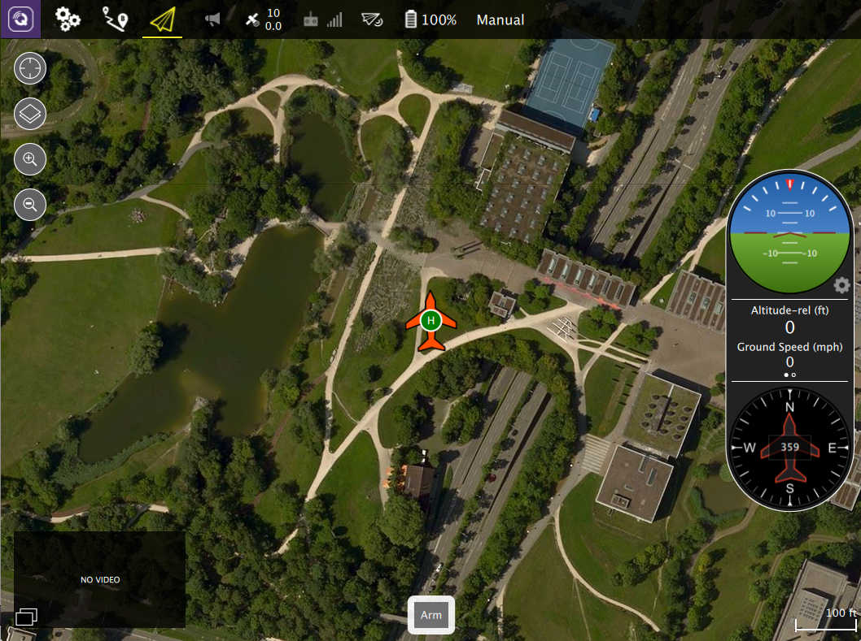
QGroundControl
Nice GUI for setting waypoints

Slide 39
Motion Model
How to control the vehicle

Slide 40
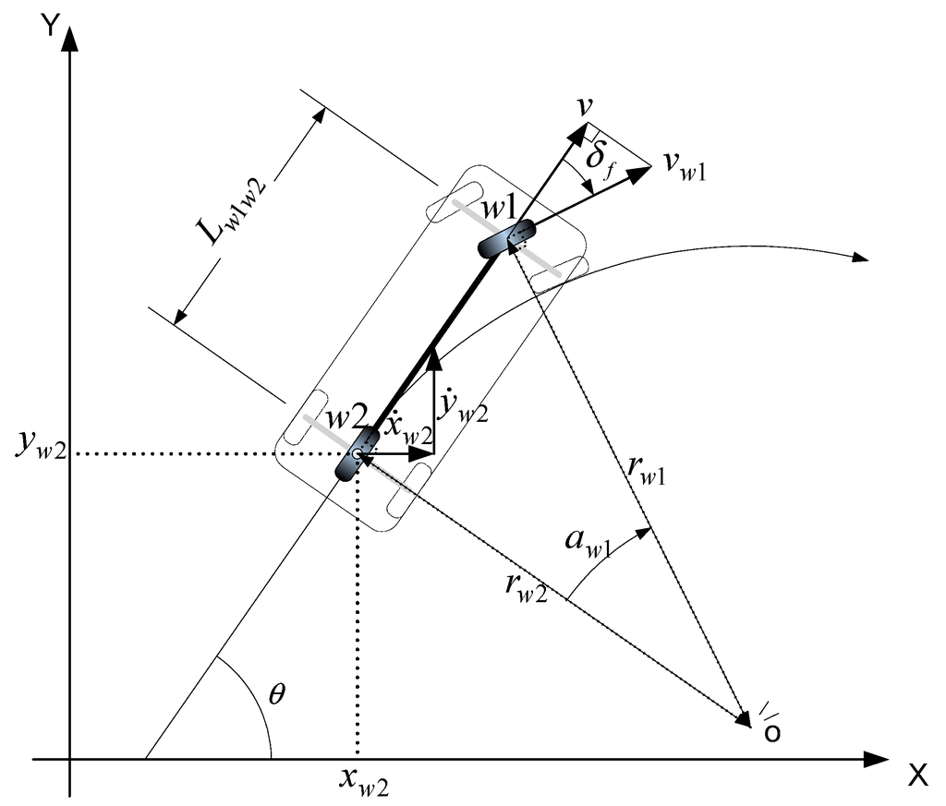
Why?
Determine the fundamental behavior of the car.
Determine the limitations of what the car can do.
A good motion model can reduce uncertainties.
Figure 1
Figure 1: http://www.mdpi.com/1424-8220/15/11/28807/htm

Slide 41
How?
Experiment
Dilemma
Things involved
Not sure if this is necessary.
Depends on how intelligent our system is.
Motor
Servos
Notes:
Depends on how intelligent our system is: like a human driving a car doesn’t need to understand the steering ratio of the car. If the turning angle is too small, a human would just apply more steering. That requires a more sophisticated system.

Slide 42
Control Model
How to have the vehicle strictly follow a path

Slide 43
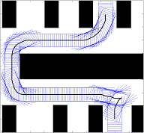
Why?
We want the vehicle to follow a pre-plan path.
But:
They go off paths even on smooth surface.
On bumpy surface, going off path is inevitable.
Figure 2
Figure 2: http://www.cs.cmu.edu/~maxim/ground.html

Slide 44
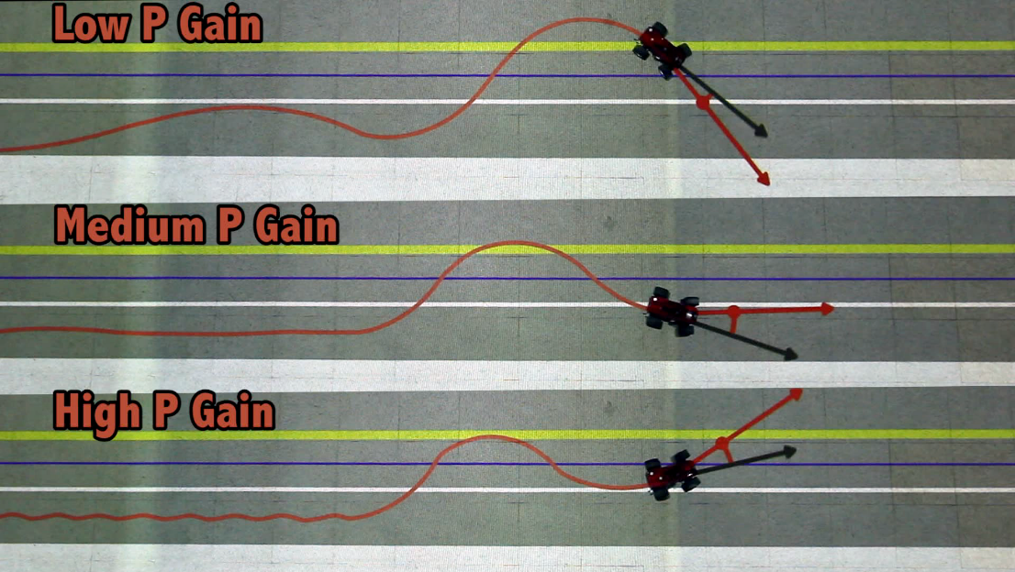
How?
PID Controller
Dilemma
Figure 3
TODO
Still don’t quite understand how it works
Understand the theory
Customize it so that we can use it on our system.
Figure 3: http://www.mit.edu/~jhow/

Slide 45
Cierra
Change the title and add an area of focus to talk about.

Slide 46
Conclusion
Summary of good things that have happened.
Summary of changes that need to be made and what we will do to make the changes.
What we will be doing next term.

